Slide 1
Unified Modeling Language - UML
University of Technical Education HCMC
Faculty of Information Technology
----o0o----
SOFTWARE DEVELOPMENT ENVIRONMENTS
Chapter 02
Lecturer: Nguyễn Trần Thi Văn
Notes:
Lecturer: Nguyễn Trần Thi Văn
Software Development Environments and Tools

Slide 2
Logical view
Lesson 03
Notes:
Lecturer: Nguyễn Trần Thi Văn
Software Development Environments and Tools

Slide 3
Class Diagram
Notes:
Lecturer: Nguyễn Trần Thi Văn
Software Development Environments and Tools

Slide 4

What is an Object?
Informally, an object represents an entity, either physical, conceptual, or software
  Physical entity
  Conceptual entity
  Software entity
Truck
Chemical Process
Linked List
Notes:
Lecturer: Nguyễn Trần Thi Văn
Software Development Environments and Tools

Slide 5
A More Formal Definition
An object is a concept, abstraction, or thing with sharp boundaries and meaning for an application
An object is something that has:
  State
  Behavior
  Identity
Notes:
Lecturer: Nguyễn Trần Thi Văn
Software Development Environments and Tools

Slide 6
An Object Has State
  The state of an object is one of the possible conditions in which an object may exist
  The state of an object normally changes over time
  The state of an object is usually implemented by a set of properties (called attributes), with the values of the properties, plus the links the object may have with other objects
a + b = 10
Name: Joyce Clark
Employee ID: 567138
Date hired: March 21, 1987
Status: Tenured
Professor Clark
Notes:
Lecturer: Nguyễn Trần Thi Văn
Software Development Environments and Tools

Slide 7

An Object Has Behavior
  Behavior determines how an object acts and reacts
  Behavior defines how an object reacts to requests from other objects
  The visible behavior of an object is modeled by the set of messages it can respond to (the operations the object can perform)
a + b = 10
Assign Professor Clark
(Returns:confirmation)
Registration System
Algebra 101 Course
Notes:
Lecturer: Nguyễn Trần Thi Văn
Software Development Environments and Tools

Slide 8



An Object Has Identity
  Each object has a unique identity, even if its state is identical to that of another object
Professor “J Clark”
teaches Algebra
Professor “J Clark”
teaches Algebra
Professor “J Clark”
teaches Algebra
Notes:
Lecturer: Nguyễn Trần Thi Văn
Software Development Environments and Tools

Slide 9
What are Classes?
  A class is a description of a group of objects with common properties (attributes), common behavior (operations), common relationships to other objects (associations and aggregations), and common semantics
    An object is an instance of a class
  A class is an abstraction in that it:
    Emphasizes relevant characteristics
    Suppresses other characteristics
  Abstraction helps us deal with complexity
Notes:
Lecturer: Nguyễn Trần Thi Văn
Software Development Environments and Tools

Slide 10
Sample Class
Class
Course
Structure
Name
Location
Days offered
Credit hours
Start time
End time
Behavior
Add a student
Delete a student
Get course roster
Determine if it is full
a + b = 10
Notes:
Lecturer: Nguyễn Trần Thi Văn
Software Development Environments and Tools

Slide 11
Classes and Objects
  A class is an abstract definition of an object
    It defines the structure and behavior of each object in the class
    It serves as a template for creating objects
  Objects may be grouped into classes
Objects
Professor
Professor Smith
Professor Mellon
Class
Professor Jones
Notes:
Lecturer: Nguyễn Trần Thi Văn
Software Development Environments and Tools

Slide 12
Finding Classes Guidelines
  A class should capture one and only one key abstraction
  Bad abstraction: Student class which knows the student information and the student schedule for the current semester
  Good abstractions: Separate classes for Student and Student Schedule
Notes:
Lecturer: Nguyễn Trần Thi Văn
Software Development Environments and Tools

Slide 13
Naming Classes
A class name should be a singular noun that best characterizes the abstraction
Difficulty in naming a class may be an indication of a poorly defined abstraction
Names should come directly from the vocabulary of the domain
Notes:
Lecturer: Nguyễn Trần Thi Văn
Software Development Environments and Tools

Slide 14
Style Guide for Naming Classes
  A style guide should dictate naming conventions for classes
  Sample style guide
    Classes are named using singular nouns
    Class names start with an upper case letter
    Underscores are not used
      Names composed of multiple words are pushed together and the first letter of each additional word is capitalized
    Example: Student, Professor, BillingSystem
Notes:
Lecturer: Nguyễn Trần Thi Văn
Software Development Environments and Tools

Slide 15
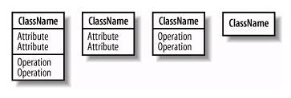
Representing Classes
  A class is represented using a compartmented rectangle
  A class is comprised of three sections
    The first section contains the class name
    The second section shows the structure (attributes)
    The third section shows the behavior (operations)
  The second and third sections may be suppressed if they need not be visible on the diagram
Notes:
Lecturer: Nguyễn Trần Thi Văn
Software Development Environments and Tools

Slide 16
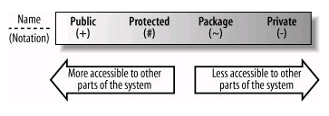
Visibility
  There are 4 visibility attributes:
    Public
    Protected
    Package
    Private
a + b = 10
Notes:
Lecturer: Nguyễn Trần Thi Văn
Software Development Environments and Tools

Slide 17
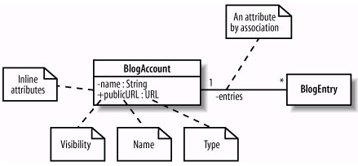
Class state: Attributes
a + b = 10
Notes:
Lecturer: Nguyễn Trần Thi Văn
Software Development Environments and Tools

Slide 18
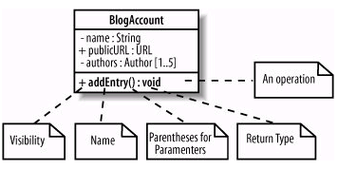
Class behavior: Functions
Notes:
Lecturer: Nguyễn Trần Thi Văn
Software Development Environments and Tools

Slide 19
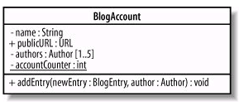
Static properties
Static properties are underlined
Notes:
Lecturer: Nguyễn Trần Thi Văn
Software Development Environments and Tools

Slide 20
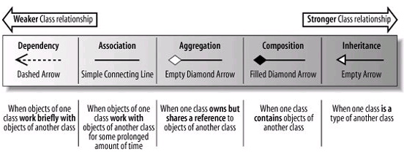
Class relationships
Notes:
Lecturer: Nguyễn Trần Thi Văn
Software Development Environments and Tools

Slide 21
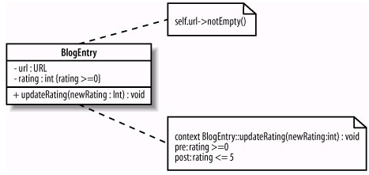
Constraints
Notes:
Lecturer: Nguyễn Trần Thi Văn
Software Development Environments and Tools

Slide 22


Abstract Class
  Abstract functions are written in italics
  A complete abstract class has its name written in italics
Notes:
Lecturer: Nguyễn Trần Thi Văn
Software Development Environments and Tools

Slide 23
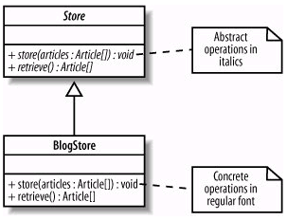
Abstract Class (2)
  When a class is derived from another class, the abstraction of functions may remain or not
Notes:
Lecturer: Nguyễn Trần Thi Văn
Software Development Environments and Tools

Slide 24
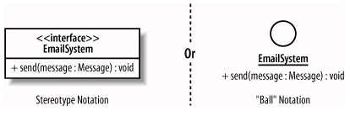
Interfaces
  An interface is a collection of operations that have no corresponding method implementations, similar to abstract class
Notes:
Lecturer: Nguyễn Trần Thi Văn
Software Development Environments and Tools

Slide 25
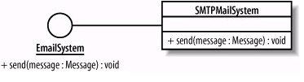
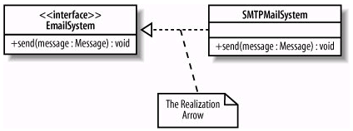
Interfaces realization
Notes:
Lecturer: Nguyễn Trần Thi Văn
Software Development Environments and Tools

Slide 26
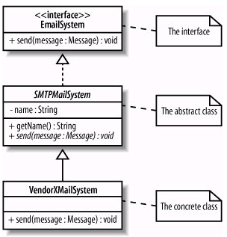
Interfaces realization (2)
The class that realizes an interface does not implement the method → it is an abstract class
Thus, it must be subclassed before initiating objects
Notes:
Lecturer: Nguyễn Trần Thi Văn
Software Development Environments and Tools

Slide 27
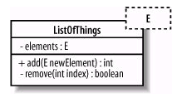
Templates
A template in UML is shown by providing an extra box with a dashed border to the top right of the regular class box
Notes:
Lecturer: Nguyễn Trần Thi Văn
Software Development Environments and Tools

Slide 28
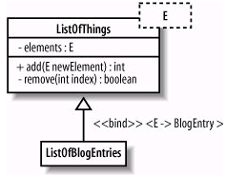
Templates - Binding
The binding process is done by subclassing
Runtime template binding will be shown in the object diagram
Notes:
Lecturer: Nguyễn Trần Thi Văn
Software Development Environments and Tools

Slide 29
Object Diagram
Notes:
Lecturer: Nguyễn Trần Thi Văn
Software Development Environments and Tools

Slide 30
What is an object?
An object is the “heart” of OO methods
An object is something that has:
  State
  Behavior
  Identity
Objects interacts with each other to help the system work
Notes:
Lecturer: Nguyễn Trần Thi Văn
Software Development Environments and Tools

Slide 31
Classes and Objects
  Every object is an instance of a class
  Objects are real entities and interact to each other in the real system
Objects
Professor
Professor Smith
Professor Mellon
Class
Professor Jones
Notes:
Lecturer: Nguyễn Trần Thi Văn
Software Development Environments and Tools

Slide 32
Object diagram
Consists of objects and links between them
Describes how objects in the system work together in a particular scenario
In another part of the logical view
Notes:
Lecturer: Nguyễn Trần Thi Văn
Software Development Environments and Tools

Slide 33



Representing Objects
An object is represent by a rectangle with its name underlined (very similar to a class notation)
a + b = 10
Name only
Name & class
Without a name
Notes:
Lecturer: Nguyễn Trần Thi Văn
Software Development Environments and Tools

Slide 34
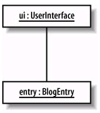
Links
  Links show the communication between objects
  Links between objects correspond to assosiation relationships between classes in the class diagram
a + b = 10
Notes:
Lecturer: Nguyễn Trần Thi Văn
Software Development Environments and Tools

Slide 35
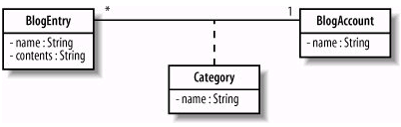
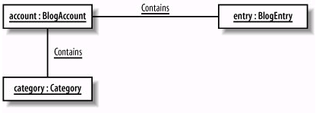
Links and Constraints
  Assosiation classes:
a + b = 10
Notes:
Lecturer: Nguyễn Trần Thi Văn
Software Development Environments and Tools

Slide 36

Links and Constraints (2)
  OCL: Object Constraint Language
a + b = 10
Notes:
Lecturer: Nguyễn Trần Thi Văn
Software Development Environments and Tools

Slide 37
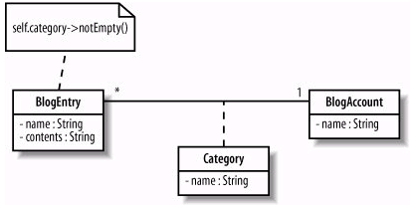
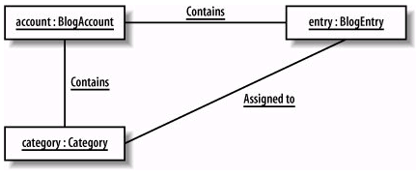
Links and Constraints (3)
  Rules in the class diagram must be kept in the object diagram
a + b = 10
Notes:
Lecturer: Nguyễn Trần Thi Văn
Software Development Environments and Tools

Slide 38
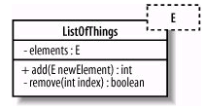

Binding templates
  Objects of a class template must be bound to one specific type
a + b = 10
Notes:
Lecturer: Nguyễn Trần Thi Văn
Software Development Environments and Tools

Slide 39

Notes:
63
Lecturer: Nguyễn Trần Thi Văn
Software Development Environments and Tools

Slide 40
THE END
Notes:
Lecturer: Nguyễn Trần Thi Văn
Software Development Environments and Tools

